Slide 1
INFO 7470/ECON 7400 Methods of Confidentiality Protection
John M. Abowd and Lars Vilhuber with a guest appearance by Aleksandra Slavković April 1, 2013

Slide 2
Outline
Why must users of restricted-access data learn about confidentiality protection?
What is statistical disclosure limitation?
What are privacy-preserving data mining and differential privacy?
Basic methods for disclosure avoidance (SDL)
Rules and methods for model-based SDL
SDL-based noise methods
Differential privacy methods

Slide 3
Why Are We Covering This?
The vast majority of data users have no exposure to the SDL techniques applied to the data they use
The tradition in SDL is to protect the details of what was done as part of the protocol
Here’s the complete description for the American Community Survey public-use micro sample: http://www.census.gov/acs/www/data_documentation/pums_confidentiality/

Slide 4
Explosion of Research in Computer Science
Differential privacy, developed by Cynthia Dwork and many collaborators fundamentally changed the nature of the discussion
The standards of modern cryptography apply:
An algorithm only provides protection if it can survive an attack by anyone armed with all the details of the protection algorithm except the actual random numbers, if any, used in the protection

Slide 5
Restricted-access Data Users
Must normally subject their analyses to statistical disclosure limitation, including limitation by differential privacy methods
It is extremely important to understand what this means for the quality of the released research and its replicability

Slide 6
Statistical Disclosure Limitation
Protection of the confidentiality of the underlying micro-data
Avoiding identity disclosure
Avoiding attribute disclosure
Avoiding inferential disclosure
Identity disclosure: who (or what entity) is in the confidential micro-data
Attribute disclosure: value of a characteristic for that entity or individual
Inferential disclosure: improvement of the posterior odds of a particular event (identity or attribute)

Slide 7
Privacy-preserving Datamining and Differential Privacy
Formally define the properties of “privacy”
Introduce algorithmic uncertainty as part of the statistical process
Prove that the algorithmic uncertainty meets the formal definition of privacy
Differential privacy defines protection in terms of making the released information about an entity as close as possible to being independent of whether or not that entity’s data are included in the tabulation data file

Slide 8
General Methods for Statistical Disclosure Limitation
At the Census Bureau SDL is called Disclosure Avoidance Review
Traditional methods
Suppression
Coarsening
Adding noise via swapping
Adding noise via sampling
Newer methods
Explicit noise infusion
Synthetic data
Formal privacy-preserving sanitizers

Slide 9
Suppression
This is by far the most common technique
Model the sensitivity of a particular data item or observation (“disclosure risk”)
Do not allow the release of data items that have excessive disclosure risk (primary suppression)
Do not allow the release of other data from which the sensitive item can be calculated (complementary suppression)

Slide 10
Suppression in Model-base Releases
Most data analysis done in the RDCs is model-based
The released data consist of summary statistics, model coefficients, standard errors, some diagnostic statistics
The SDL technique used for these releases is usually suppression: the suppression rules are contained (up to confidential parameters) in the RDC Researcher’s Handbook

Slide 11
Coarsening
Coarsening is the creation of a smaller number of categories from the variable in order to increase the number of cases in each cell
Computer scientists call this “generalizing”
Geographic coarsening: block-block group-tract-minor civil division-county-state-region
Top coding of income is a form of coarsening
All continuous variables in a micro-data file can be considered coarsened to the level of precision (significant digits) released
This method is often applied to model-based data releases by restricting the number of significant digits that can be released

Slide 12
Swapping
Estimate the disclosure risk of certain attributes or individuals
If the risk is too great, attributes of one data record are (randomly) swapped with the same attributes of another record
If geographic attributes are swapped this has the effect of placing the risky attributes in a different location from the truth
Commonly used in household censuses and surveys
Rarely used with establishment data

Slide 13
Sampling
Sampling is the original SDL technique
By only selecting certain entities from the population on which to collect additional data (data not on the frame), uncertainty about which entity was sampled provides some protection
In modern, detailed surveys, sampling is of limited use for SDL

Slide 14
Rules and Methods for Model-based SDL
Refer to Chapter 3 of the RDC Researcher’s Handbook
Suppress: coefficients on detailed indicator variables, on cells with too few entities
Smooth: density estimation and quantiles, use a kernel density estimator to produce quantiles
Coarsen: variables with heavy tails (earnings, payroll), residuals (truncate range, suppress labels of range)

Slide 15
SDL by Noise Infusion
Introduction
Application to the Quarterly Workforce Indicators
Measures of protection
Measures of analytical validity

Slide 16
Explicit Noise Infusion
Adding noise to the published item or to the underlying micro data to disguise the true value
Example: QWIs and work place data in OTM
Original method developed by Evans, T., Zayatz, L., and Slanta, J. (1998). “Using Noise for Disclosure Limitation of Establishment Tabular Data,” Journal of Official Statistics Vol. 14 (December): 537-51.

Slide 17
The Quarterly Workforce Indicator System
Multiplicative noise infusion system
Establishment level micro data are distorted according to a permanent distortion factor
Distortion factor always moves the fuzzed item away from the actual item by a minimum and maximum percentage
All release data are computed from the fuzzed items

Slide 18
References for QWI
Abowd, J. M., Stephens, B. E., Vilhuber L. (2005). Confidentiality Protection in the Census Bureau’s Quarterly Workforce Indicators, mimeo, U.S. Census Bureau, LEHD and Cornell University (LEHD TP-2006-02)
Abowd, J.M., Gittings, R.K., Stephens, B. E., and Vilhuber, L. “Combining Synthetic Data and Noise Infusion for Confidentiality Protection of the Quarterly Workforce Indicators,” chapter 2 of Gittings Ph.D. thesis.

Slide 19
Noise Factor Distribution

Slide 20
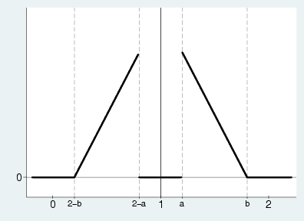
Graph of Noise Distribution

Slide 21
Implementation of Noise Infusion
Counts: B, E, M, F, A, S, H, R, FA, FS, W1, W2, W3, NA, NH, NR, and NS
Ratios: Z_W2, Z_W3, Z_WA, Z_WS, Z_NA, Z_NH, Z_NR, and Z_NS
Differences: JF, JC, JD, FJF, FJC, FJD, DWA, DWFA, DWS, DWFS
In OTM, B is distorted as a count

Slide 22
Multiplicative Noise Infusion
B is beginning of quarter employment; E is end of period; E-bar is the average.
Z_W2 is end of quarter employee earnings, W2 is total payroll for end of quarter employees.
JF is net job flows
Asterisk indicates distorted values.

Slide 23
Weighting
Each fuzzed micro-data item is weighted by the QWI final weight before aggregation
This means that all input data are real numbers (not integers)
Final disclosure control formulas must reflect rounding of the counts

Slide 24
Protection Properties of the QWI Algorithm

Slide 25
Table 1A Variable: B Unweighted/Undistorted vs. Unweighted/Distorted
 | 0 | 1 | 2 | 3 | 4 | 5+
0 | 99.61 | 0.39 | 0.00 | 0.00 | 0.00 | 0.00
1 | 0.00 | 98.57 | 1.43 | 0.00 | 0.00 | 0.00
2 | 0.00 | 1.04 | 96.10 | 2.85 | 0.00 | 0.00
3 | 0.00 | 0.00 | 2.19 | 93.21 | 4.60 | 0.00
4 | 0.00 | 0.00 | 0.00 | 7.30 | 82.52 | 10.18
5+ | 0.00 | 0.00 | 0.00 | 0.00 | 1.60 | 98.40
Note: The data represent county data for Maryland/NAICS Industry Group. Cells represent row percentages and sum to 100.

Slide 26
Table 1B Variable: B Unweighted/Undistorted vs. Weighted/Distorted
 | 0 | 1 | 2 | 3 | 4 | 5+
0 | 99.19 | 0.81 | 0.00 | 0.00 | 0.00 | 0.00
1 | 0.14 | 89.29 | 10.56 | 0.01 | 0.00 | 0.00
2 | 0.04 | 1.39 | 67.45 | 30.70 | 0.42 | 0.00
3 | 0.03 | 0.04 | 2.19 | 50.99 | 42.76 | 3.99
4 | 0.03 | 0.02 | 0.03 | 3.07 | 41.04 | 55.81
5+ | 0.01 | 0.00 | 0.00 | 0.02 | 0.33 | 99.64
Note: The data represent county data for Maryland/NAICS Industry Group. Cells represent row percentages and sum to 100.

Slide 27
Table 1C Variable: B Unweighted/Undistorted vs. Synthesized
 | 0 | 1 | 2 | 3 | 4 | 5+
0 | 99.17 | 0.82 | 0.01 | 0.00 | 0.00 | 0.00
1 | 7.85 | 84.74 | 6.62 | 0.78 | 0.01 | 0.00
2 | 0.51 | 11.93 | 61.06 | 24.14 | 2.24 | 0.12
3 | 0.06 | 0.76 | 7.53 | 47.50 | 39.13 | 5.02
4 | 0.03 | 0.11 | 0.93 | 7.40 | 38.84 | 52.69
5+ | 0.01 | 0.01 | 0.01 | 0.11 | 0.71 | 99.16
Note: The data represent county data for Maryland/NAICS Industry Group. Cells represent row percentages and sum to 100.

Slide 28
Analytical Validity Properties

Slide 29
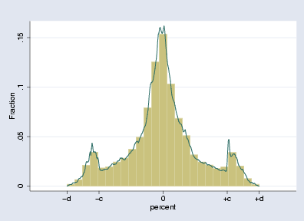
Error Distribution for B (Micro-data)

Slide 30
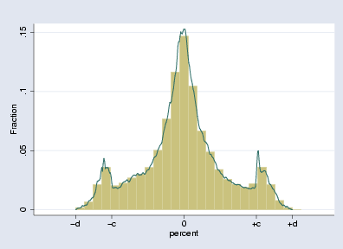
Error Distribution for W (Micro-data)

Slide 31
Table 7
Distribution of the Difference Between Autocorrelation Coefficients Unweighted/Undistorted vs. Unweighted/Distorted
Percentile | B | H | R | E | A | S | M | F | FA | FS | H3
99 | 0.067 | 0.058 | 0.042 | 0.066 | 0.061 | 0.061 | 0.079 | 0.059 | 0.056 | 0.054 | 0.056
95 | 0.036 | 0.035 | 0.025 | 0.036 | 0.036 | 0.036 | 0.042 | 0.032 | 0.034 | 0.033 | 0.035
90 | 0.025 | 0.025 | 0.015 | 0.024 | 0.025 | 0.025 | 0.028 | 0.021 | 0.024 | 0.023 | 0.024
75 | 0.009 | 0.009 | 0.005 | 0.009 | 0.010 | 0.010 | 0.011 | 0.008 | 0.009 | 0.008 | 0.008
50 | 0.000 | 0.000 | 0.000 | 0.000 | 0.000 | 0.000 | 0.000 | 0.000 | 0.000 | 0.000 | 0.000
25 | -0.008 | -0.011 | -0.005 | -0.009 | -0.010 | -0.010 | -0.011 | -0.008 | -0.009 | -0.008 | -0.009
10 | -0.023 | -0.028 | -0.016 | -0.023 | -0.026 | -0.026 | -0.027 | -0.022 | -0.026 | -0.024 | -0.026
5 | -0.035 | -0.038 | -0.025 | -0.037 | -0.036 | -0.038 | -0.041 | -0.033 | -0.037 | -0.035 | -0.038
1 | -0.061 | -0.063 | -0.045 | -0.065 | -0.059 | -0.065 | -0.074 | -0.061 | -0.061 | -0.059 | -0.062
Note: The data represent county data for Maryland/NAICS Industry Group. Cells represent the difference between the autocorrelation coefficients the percentile designated by the rows.

Slide 32
Table 8
Distribution of the Difference Between Autocorrelation Coefficients Unweighted/Undistorted vs. Weighted/Distorted w/ Suppressions
Percentile | B | H | R | E | A | S | M | F | FA | FS | H3
99 | 0.318 | 0.592 | 0.538 | 0.325 | 0.602 | 0.652 | 0.330 | 0.366 | 0.606 | 0.656 | 0.648
95 | 0.153 | 0.326 | 0.221 | 0.158 | 0.294 | 0.304 | 0.134 | 0.181 | 0.317 | 0.352 | 0.359
90 | 0.086 | 0.196 | 0.136 | 0.084 | 0.173 | 0.181 | 0.063 | 0.108 | 0.196 | 0.218 | 0.229
75 | 0.021 | 0.060 | 0.049 | 0.019 | 0.053 | 0.053 | 0.017 | 0.025 | 0.068 | 0.070 | 0.087
50 | -0.002 | -0.006 | 0.000 | -0.003 | -0.006 | -0.008 | -0.006 | -0.001 | -0.004 | -0.004 | -0.001
25 | -0.029 | -0.075 | -0.063 | -0.031 | -0.071 | -0.078 | -0.037 | -0.026 | -0.070 | -0.084 | -0.082
10 | -0.085 | -0.188 | -0.162 | -0.091 | -0.170 | -0.190 | -0.099 | -0.077 | -0.169 | -0.200 | -0.190
5 | -0.150 | -0.289 | -0.242 | -0.154 | -0.258 | -0.288 | -0.176 | -0.141 | -0.262 | -0.300 | -0.286
1 | -0.393 | -0.551 | -0.474 | -0.426 | -0.505 | -0.531 | -0.489 | -0.419 | -0.499 | -0.538 | -0.527
Note: The data represent county data for Maryland/NAICS Industry Group. Cells represent the difference between the autocorrelation coefficients the percentile designated by the rows.

Slide 33
Table 9
Distribution of the Difference Between Autocorrelation Coefficients Unweighted/Undistorted vs. Weighted/Distorted w/ Synthetic Replacements
Percentile | B | H | R | E | A | S | M | F | FA | FS | H3
99 | 0.107 | 0.246 | 0.223 | 0.096 | 0.238 | 0.263 | 0.210 | 0.227 | 0.260 | 0.157 | 0.294
95 | 0.056 | 0.144 | 0.126 | 0.051 | 0.134 | 0.166 | 0.123 | 0.112 | 0.145 | 0.076 | 0.185
90 | 0.036 | 0.104 | 0.092 | 0.033 | 0.099 | 0.120 | 0.084 | 0.075 | 0.108 | 0.049 | 0.133
75 | 0.011 | 0.050 | 0.043 | 0.010 | 0.047 | 0.058 | 0.037 | 0.031 | 0.051 | 0.018 | 0.066
50 | -0.004 | 0.003 | 0.007 | -0.005 | 0.005 | 0.007 | 0.006 | 0.002 | 0.007 | -0.003 | 0.009
25 | -0.030 | -0.043 | -0.013 | -0.030 | -0.032 | -0.032 | -0.017 | -0.018 | -0.030 | -0.034 | -0.037
10 | -0.065 | -0.109 | -0.067 | -0.064 | -0.089 | -0.095 | -0.049 | -0.056 | -0.095 | -0.082 | -0.128
5 | -0.092 | -0.167 | -0.120 | -0.093 | -0.142 | -0.145 | -0.081 | -0.088 | -0.144 | -0.116 | -0.194
1 | -0.166 | -0.295 | -0.257 | -0.176 | -0.257 | -0.268 | -0.168 | -0.187 | -0.277 | -0.233 | -0.343
Note: The data represent county data for Maryland/NAICS Industry Group. Cells represent the difference between the autocorrelation coefficients the percentile designated by the rows.

Slide 34
QWIPU: Aggregating Formulas
Counts and magnitudes:
Add
Ratios and differences
Multiply by released base
Aggregate numerator and denominator separately
Add
Job creations and destructions
Handle like counts but understand that there is an inherent loss of information

Slide 35
QWIPU: Handling the Suppressions
Status flag 5 suppressions
Must be treated as missing data and estimated
Status flag 9 data
Not suppressed; should be used as published

Slide 36
Research Uses of the Micro-data
QWI Micro-data (UFF_B)
Use the undistorted confidential data (establishment level) in models
Use conventional model-based disclosure avoidance rules
No fuzzed data should be used
OTM Micro-data (WHAT_B)
All micro-data and all imputations of missing data used to build OTM
Contain both fuzzed and unfuzzed values with separate weights
Unfuzzed data should be used in models, weighted as appropriate

Slide 37
Cryptographic and Statistical Advances in Confidentiality Protection

Slide 38
Outline
Motivation: formal privacy models and statistical disclosure limitation
The basic OnTheMap application
The statistical structure of the OnTheMap data
Applying differential privacy to OnTheMap
The trade-off between analytical validity and confidentiality protection
Other recent developments

Slide 39
Formal Privacy Models and Statistical Disclosure Limitation
Formal privacy protection methods are based on open algorithms with provable properties
The standard in privacy-preserving datamining or differential privacy is based on cryptography
Only the private key (password, encryption key) is confidential; all algorithms and parameters are public
Attacker (= user) can have massive amounts of prior information

Slide 40
The Cryptographic Critique of SDL
Standard SDL techniques fail because
They and do not have provably protective properties when the attacker (= user) is allowed full access to the algorithm
They depend upon the realized data and not the algorithm
Many standard SDL techniques are viewed as very risky when the cryptographic critique is applied

Slide 41
Point of Common Ground
Federal Committee on Statistical Methodology working paper 22 offers the desirable disclosure avoidance property:
Evfimievski, Gehrke and Srikant (2003), Dwork (2006) show that disclosure avoidance in this sense is impossible to achieve in general
Disclosure relates to inappropriate attribution of information to a data subject, whether an individual or an organization. Disclosure occurs when a data subject is identified from a released file (identity disclosure), sensitive information about a data subject is revealed through the released file (attribute disclosure), or the released data make it possible to determine the value of some characteristic of an individual more accurately than otherwise would have been possible (inferential disclosure). (page 4)

Slide 42
Focus on Synthetic Data and Randomized Sanitizers
The SDL technique known as synthetic data most closely resembles the cryptographic data protection techniques
The cryptographic techniques are known as differential privacy, privacy-preserving datamining, randomized sanitizers, and e-privacy.

Slide 43
Definition of Synthetic Data
Synthetic data are created by estimating the posterior predictive distribution (PPD) of the release data given the confidential data; then sampling release data from the PPD conditioning on the actual confidential values
The PPD is a parameter-free forecasting model for new values of the complete data matrix that conditions on all values of the underlying confidential data

Slide 44
Connection to Randomized Sanitizers
A randomized sanitizer creates a conditional probability distribution for the release data given the confidential data
The randomness in a sanitizer is induced by the properties of the distribution of U
The PPD is just a particular randomized sanitizer

Slide 45
ε-Differential Privacy
Differential privacy (Dwork, and many co-authors) is difficult to maintain in sparse applications when geographically near blocks have very different posterior probabilities

Slide 46
Disclosure Set
This set describes the outcomes where differential privacy fails

Slide 47
Probabilistic Differential Privacy or (ε,δ) Differential Privacy
PDP allows us to control the probability that differential privacy fails
The analytical validity of sparse applications can be controlled with PDP because the restrictions on the prior used in the synthesizer are reasonable for use with sparse tables

Slide 48
(ε,δ)-Differential Privacy
Probabilistic differential privacy and (ε,δ)-differential privacy are equivalent

Slide 49
Disclosure Limitation Definitions
Consider two confidential data matrices that differ in only a single row, x⁽¹⁾ and x⁽²⁾
Use the PPD to evaluate the probability of a particular release data set given the two different confidential data sets

Slide 50
Synthetic Data Can Leak Information about a Single Entity
Changing a single row of the confidential data matrix changes the PPD or the random sanitizer
The PPD or the random sanitizer define the transition probabilities from the confidential data to the release data
True for all SDL procedures that infuse noise

Slide 51
Connection Between Synthetic Data and Differential Privacy
The posterior odds ratio for the gain in information about a single row of X is equal to the differential privacy from the randomized sanitizer that creates release data by sampling from the specified conditional distribution.

Slide 52
Connection Between Differential Privacy and Inferential Disclosure
The posterior odds ratio for the gain in information about a single row of X is the Dalenius (1977) definition of an inferential disclosure. Bounding the differential privacy therefore bounds the inferential disclosure.

Slide 53
Taking Account of Formal Privacy Models
A variety of papers in the cryptographic data privacy literature (Dwork, Nissim and their many collaborators, Gehrke and his collaborators, and others) show that the confidentiality protection afforded by synthetic data or a randomized sanitizer depends upon properties of the transition probabilities that relate the confidential data to the release data.
Exact data releases are not safe. Not surprising since
implies that the sanitizer leaves the confidential data unchanged .
Off-diagonal elements that are zero imply infinite differential privacy: exact disclosure in some cases with probability 1.
For a full explanation of the relation between the transition matrix and differential privacy measures see Abowd and Vilhuber (2008).

Slide 54
Relationship to Post-randomization
Post-randomization (Kooiman et al. 1997) focuses on the diagonal elements of
When off-diagonal elements of this transition matrix are zero, infinite differential privacy usually results
Swapping, shuffling, stratified sampling, and most noise-infusion methods result in off-diagonal elements that are zero

Slide 55
A Detailed Example: Synthetic data

Slide 56
The Multinomial-Dirichlet Model
The data matrix X consists of categorical variables that can by summarized by a contingency table with k categories.
n_{i} are counts.
π_{i} are probabilities

Slide 57
The Multinomial-Dirichlet Synthesizer
The synthetic data are samples from the synthesizer, and can be summarized by their counts, m
Since all the random variables are discrete, the synthesizer can be expressed as a simple transition probability matrix

Slide 58
 | m₁ | 0 | 1 | 2 | 3 | 4 | 5
 | m₂ | 5 | 4 | 3 | 2 | 1 | 0
n₁ | n₂
0 | 5 | 0.647228 | 0.294194 | 0.053490 | 0.004863 | 0.000221 | 0.000004
1 | 4 | 0.237305 | 0.395508 | 0.263672 | 0.087891 | 0.014648 | 0.000977
2 | 3 | 0.067544 | 0.241227 | 0.344610 | 0.246150 | 0.087911 | 0.012559
3 | 2 | 0.012559 | 0.087911 | 0.246150 | 0.344610 | 0.241227 | 0.067544
4 | 1 | 0.000977 | 0.014648 | 0.087891 | 0.263672 | 0.395508 | 0.237305
5 | 0 | 0.000004 | 0.000221 | 0.004863 | 0.053490 | 0.294194 | 0.647228
k = 2
α_{i} = ½; α₀ = 1
n = m = 5
The table displays the transition probabilities that map n into m

Slide 59
ε-Differential Privacy
The two confidential data matrices, n⁽¹⁾ and n⁽²⁾ differ by changing exactly one entity’s data
Bounding by ε the log inferential disclosure odds ratio in the M-D synthesizer amounts to controlling the probabilities in Pr[m|n] appropriately

Slide 60
 |  |  | m₁ | 0 | 1 | 2 | 3 | 4 | 5
 |  |  | m₂ | 5 | 4 | 3 | 2 | 1 | 0
n⁽¹⁾₁ | n⁽¹⁾₂ | n⁽²⁾₁ | n⁽²⁾₂
0 | 5 | 1 | 4 | 1.003353 | 0.29593 | 1.595212 | 2.894495 | 4.193778 | 5.493061
1 | 4 | 2 | 3 | 1.256572 | 0.494432 | 0.267708 | 1.029848 | 1.791988 | 2.554128
2 | 3 | 3 | 2 | 1.682361 | 1.009417 | 0.336472 | 0.336472 | 1.009417 | 1.682361
3 | 2 | 4 | 1 | 2.554128 | 1.791988 | 1.029848 | 0.267708 | 0.494432 | 1.256572
4 | 1 | 5 | 0 | 5.493061 | 4.193778 | 2.894495 | 1.595212 | 0.29593 | 1.003353
The table shows all of the differential privacy ratios for the example problem
The ε-differential privacy of this synthesizer is the maximum element in this table, 5.493061
The differential privacy limit is attained when the synthesizer delivers (0,5) and the underlying data are either (5,0) or (4,1) (or (0,5) with original data (1,4) or (5,0))
If I release (5,0) and you know 4 people are in category 2, then the odds are 243:1 (= exp(5.493061)) that the unknown person is in category 1

Slide 61
Probabilistic Differential Privacy
This definition of differential privacy allows the ε-differential privacy limit to fail with probability δ (Machanavajjhala et al. 2008)
To compute the PDP, the joint distribution of m and n must be examined for outcomes with differential privacy that exceed the limit to ensure that they occur with total probability less than δ

Slide 62
 | m₁ | 0 | 1 | 2 | 3 | 4 | 5
 | m₂ | 5 | 4 | 3 | 2 | 1 | 0
n₁ | n₂
0 | 5 | 0.020226 | 0.009194 | 0.001672 | 0.000152 | 6.91E-06 | 1.26E-07
1 | 4 | 0.037079 | 0.061798 | 0.041199 | 0.013733 | 0.002289 | 0.000153
2 | 3 | 0.021107 | 0.075383 | 0.107691 | 0.076922 | 0.027472 | 0.003925
3 | 2 | 0.003925 | 0.027472 | 0.076922 | 0.107691 | 0.075383 | 0.021107
4 | 1 | 0.000153 | 0.002289 | 0.013733 | 0.041199 | 0.061798 | 0.037079
5 | 0 | 1.26E-07 | 6.91E-06 | 0.000152 | 0.001672 | 0.009194 | 0.020226
The table is Pr[m,n], where the marginal Pr[n] is based on the prior D(α)
If we want to have ε-differential privacy of 2, then the synthesizer fails in the highlighted cells
With prior D(α), probabilistic differential privacy has ε = 2 and δ < 0.000623, which is just the sum of the highlighted cells in each row (row by row)

Slide 63
A Detailed Example: Random Sanitizer

Slide 64
Laplace Sanitizer
Dwork et al. (2006) show that ε-differential privacy can be achieved in the Multinomial model with a sanitizer using independent double exponential noise (Laplace noise) with mean zero and variance 2/ε
The numerator, 2, is called the “global sensitvity”
Note that in our application the total n is released without noise

Slide 65
 | m₁ | 0 | 1 | 2 | 3 | 4 | 5
 | m₂ | 5 | 4 | 3 | 2 | 1 | 0
n₁ | n₂
0 | 5 | 0.816060 | 0.159046 | 0.021525 | 0.002913 | 0.000394 | 0.000062
1 | 4 | 0.183940 | 0.632121 | 0.159046 | 0.021525 | 0.002913 | 0.000456
2 | 3 | 0.024894 | 0.159046 | 0.632121 | 0.159046 | 0.021525 | 0.003369
3 | 2 | 0.003369 | 0.021525 | 0.159046 | 0.632121 | 0.159046 | 0.024894
4 | 1 | 0.000456 | 0.002913 | 0.021525 | 0.159046 | 0.632121 | 0.183940
5 | 0 | 0.000062 | 0.000394 | 0.002913 | 0.021525 | 0.159046 | 0.816060
k = 2
n = m = 5
ε = 2
The table displays the transition probabilities that map n into m
Note that the diagonals are larger than the M-D model and the extreme outcomes have greater probability

Slide 66
 |  |  | m₁ | 0 | 1 | 2 | 3 | 4 | 5
 |  |  | m₂ | 5 | 4 | 3 | 2 | 1 | 0
n⁽¹⁾₁ | n⁽¹⁾₂ | n⁽²⁾₁ | n⁽²⁾₂
0 | 5 | 1 | 4 | 1.489880 | 1.379885 | 2.000000 | 2.000000 | 2.000000 | 2.000000
1 | 4 | 2 | 3 | 2.000000 | 1.379885 | 1.379885 | 2.000000 | 2.000000 | 2.000000
2 | 3 | 3 | 2 | 2.000000 | 2.000000 | 1.379885 | 1.379885 | 2.000000 | 2.000000
3 | 2 | 4 | 1 | 2.000000 | 2.000000 | 2.000000 | 1.379885 | 1.379885 | 2.000000
4 | 1 | 5 | 0 | 2.000000 | 2.000000 | 2.000000 | 2.000000 | 1.379885 | 1.489880
The table confirms that the transition matrix on the previous page has ε = 2

Slide 67
Challenges and Applications
Realistic problems are all very sparse
Probabilistic differential privacy can solve the sparseness problem
But, it requires coarsening and domain shrinking to deliver acceptable analytical validity.
The Laplace synthesizer can solve the sparseness problem by adaptive histogram coarsening or the sparse vector method
But the user cannot directly control the coarsening hence analytical validity for some hypotheses is low
OnTheMap uses probabilistic differential privacy

Slide 68
A REAL APPLICATION: US CENSUS BUREAU’S ONTHEMAP/LODES

Slide 69
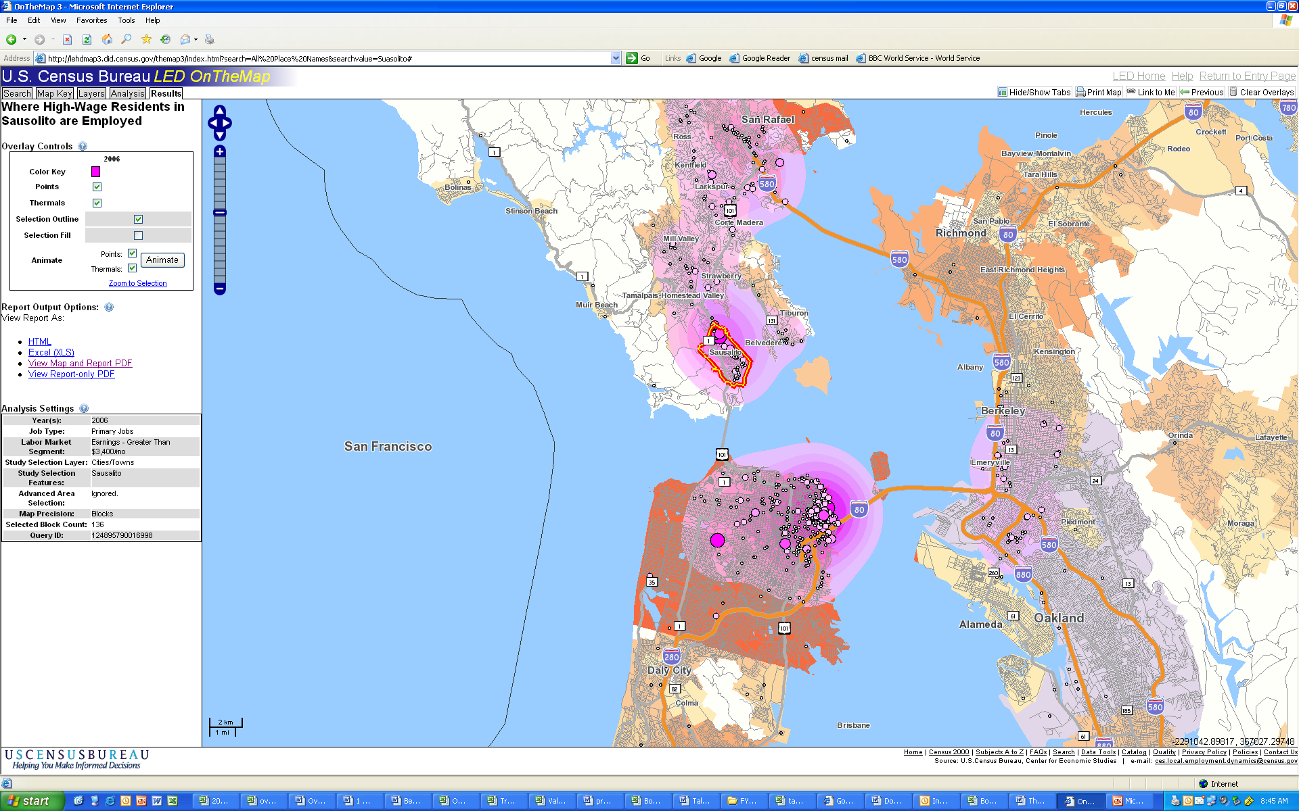
Where residents of Sausalito, CA with high wages are employed

Slide 70
The OnTheMap/LODES Data Structure
Set of linked data tables with a relational database schema
Main tables (micro-data)
Job: [Person_ID, Employer_ID, …]
Residence: [Person_ID, Origin_Block, …]
Workplace: [Employer_ID, Destination_Block, …]
Geo-code: [Block, Tract, Latitude, Longitude, …]

Slide 71
Detailed Geo-spatial Data in OTM/LODES
Workplace and residence geographies are defined using Census blocks
Statistical analysis to estimate the PPD is based on Census tract-to-tract relations
There are 8.2 million blocks and 65,000 tracts in the U.S. (Census 2000 geography)
Every workplace block with positive employment has its own synthesizer

Slide 72
Dirichlet-Multinomial Synthesizer
I residences (origins)
Model each workplace (destination) j separately for each demographic segment (age, earnings, industry)
Sample data X tabulated into n
Synthetic data tabulated into m
Often, m = n, but not in the OTM application

Slide 73
Synthetic Data Model
Likelihood of place of residence (index i) conditional on place of work (index j) and characteristics (index k):
The resulting posterior for π is Dirichlet with parameter n_{jk} + α_{jk} for each unique workplace and characteristic combination (age, earnings, industry, race, ethnicity, education).
Synthesize residence counts by sampling from the posterior predictive distributions conditional on already protected (and published) destination employment counts, m_{jk}

Slide 74
Search Algorithm Implements PDP
We rely on the concept of (ε ,δ)-probabilistic differential privacy, which guarantees ε-differential privacy with 1-δ confidence (Machanavajjhala et al. (2008)).
Search algorithm finds the minimum prior sample size to guarantee ε-differential privacy with failure probability δ.
This minimum prior sample size is then used as the lower bound of the prior sample sizes (α) .
The privacy-preserving algorithm implemented in OnTheMap guarantees ε -differential privacy protection of 8.99 with 99.999999% confidence (δ = 0.000001).

Slide 75
Measures to Improve Validity
Coarsening of the domain
Reducing the number of support points in the domain of the prior
Editing the prior domain
Eliminating the most unlikely commute patterns (from prior and likelihood) based on previously published data
Use of informative priors
Impose likely shape based on previously published data subject to minimum prior sample size that ensures (ε,δ)-PDP
Pruning the posterior
Randomly eliminating a fraction support points with no likelihood support
Pruning comes with a penalty in terms of privacy protection

Slide 76
Refinement: Coarsening the Domain
Blocks are collected into larger geographic areas- SuperPUMAs, PUMAs, Tracts
Reduces the dimensionality of the domain of each destination’s synthesizer
Theorem 5.1 in Machanavajjhala et al. shows that ε-differential privacy, and (ε,δ)-probabilistic differential privacy both survive coarsening with unchanged parameters

Slide 77
Coarsening Steps
If origin block very far away from destination block (distance > 90th percentile of CTTP commute distribution) coarsened to Super-PUMA (400,000 population in Census 2000)
Else if origin block far away from destination block (distance > 50th percentile of CTTP commute distribution) coarsened to PUMA (100,000 population in Census 2000)
Else if origin block close to destination block (distance < 50th percentile of CTTP commute distribution) coarsened to Census Tract (4,000 population on average).
Idea: “marginal differences in commute distances between candidate locations have less predictive power in allocating workers the farther away the locations are”

Slide 78
Effects of Coarsening
Coarsening in formal privacy models is effectively the same as coarsening in traditional methods
After coarsening, an entity (in this case a block) is chosen randomly to represent the coarsened unit (one block per SuperPUMA, PUMA, or tract, as appropriate)
This ensures that the transition matrix has no zero elements at the block level
Ratios of the elements of this transition matrix determine the differential privacy

Slide 79
Refinement: Editing the Prior Domain
For each work tract:
if point in domain has zero probability in prior data then do:
eliminate point with p=0.98 if distance > 500 miles
eliminate point with p=0.9 if distance > 200 miles
eliminate point with p=0.5 if distance > 100 miles
do not eliminate if distance < 100 miles
else retain point
Note: contribution of any likelihood data in eliminated points also eliminated

Slide 80
Fraction of Points in the Prior Domain with Positive Counts in Census Transportation Planning Package Data
 | State A |  | State B |  | State C
Distance (in miles) | Mean | SD | Mean | SD | Mean | SD
- low-10 | 0.47 | 0.37 | 0.40 | 0.32 | 0.92 | 0.18
- 10-25 | 0.30 | 0.26 | 0.19 | 0.19 | 0.63 | 0.29
- 25-100 | 0.01 | 0.13 | 0.09 | 0.10 | 0.15 | 0.16
- 100-500 | 0.01 | 0.03 | 0.01 | 0.02 | 0.02 | 0.04
- 500-high | 0.00 | 0.01 | 0.00 | 0.01 | 0.00 | 0.00
All | 0.18 | 0.28 | 0.14 | 0.23 | 0.34 | 0.40

Slide 81
Fraction of Points in the Domain with Positive Counts in CTPP after Eliminating Extremely Unlikely Commute Patterns
 | Large State |  | Medium State |  | Small State
distance (in miles) | Mean | SD | Mean | SD | Mean | SD
- low-10 | 0.47 | 0.37 | 0.40 | 0.32 | 0.92 | 0.18
- 10-25 | 0.30 | 0.26 | 0.19 | 0.19 | 0.63 | 0.29
- 25-100 | 0.13 | 0.13 | 0.09 | 0.10 | 0.15 | 0.16
- 100-500 | 0.06 | 0.09 | 0.03 | 0.06 | 0.08 | 0.14
- 500-high | 0.07 | 0.13 | 0.06 | 0.12 | 0.03 | 0.08
All | 0.21 | 0.27 | 0.15 | 0.23 | 0.36 | 0.39
Fraction of likelihood data eliminated by eliminating unlikely commute patterns is about 3-7% depending on state and year

Slide 82
Support Points in Prior Domain (before Posterior Pruning)
 | Large State (A) |  |  | Medium State (B) |  |  | Small State (C)
Support points: | Mean | Min | Max | Mean | Min | Max | Mean | Min | Max
Total | 1,005 | 583 | 2,067 | 1,027 | 619 | 1,560 | 672 | 602 | 818
By level of coarsening
- Super-PUMA | 526 | 519 | 538 | 526 | 518 | 539 | 537 | 535 | 539
- PUMA | 39 | 9 | 73 | 47 | 7 | 79 | 10 | 4 | 19
- Census Tract | 438 | 32 | 1,506 | 453 | 72 | 998 | 125 | 56 | 272
By distance (in miles) between centroids
- low-10 | 265 | 1 | 878 | 188 | 1 | 438 | 15 | 1 | 49
- 10-25 | 127 | 8 | 794 | 195 | 13 | 612 | 16 | 1 | 60
- 25-100 | 85 | 23 | 289 | 121 | 45 | 296 | 54 | 15 | 169
- 100-500 | 139 | 119 | 206 | 181 | 151 | 238 | 80 | 29 | 233
- 500-high | 389 | 361 | 412 | 343 | 300 | 373 | 508 | 486 | 519

Slide 83
Refinement: Informative Priors
In year 2002: Public-use CTTP data
In year 2003-2010: Public-use previous year OnTheMap data (not posterior)
α = max[min_alpha, f(prior density)] minimum prior sample size is the larger of the PDP value (min_alpha) or the informative prior value
Priors unique to each employment tract
Not strictly Bayesian because the posterior is not published, and published data are required for prior by PDP

Slide 84
Refinement: Posterior Domain Pruning
Domain may still have too many blocks for good analytical validity
Algorithm 2 prunes the posterior domain for a given destination j:
Keep all origins in the likelihood support (confidential data)
For all other origins, add to domain with probability f_{i}; (generates min_p below)
From Machanavajjhala et al. 2008:

Slide 85
Effects of Posterior Domain Pruning
Posterior domain pruning leaves all of the support points that appear in the likelihood function in the posterior
Posterior domain pruning removes some of the prior support points that have no likelihood
Posterior domain improves analytical validity, but because it depends upon the confidential data, it increases the effective differential privacy limit

Slide 86
Final Privacy Settings for OnTheMap/LODES
Unadjusted ε = 4.6
Probability of failure δ = 0.000001
Minimum retention probability min_p= 0.025
Adjusted ε = 8.9
Kullback-Leibler and Integrated Mean Squared Error loss functions used to set parameters of prior
Multinomial-Dirichlet Posterior sampled for every workplace block in the U.S. (about 1.4 million)

Slide 87
Analytical Validity Measures
The divergence between posterior and likelihood for a population is measured by the Kullback-Leibler Divergence index (KL) and the Integrated Mean Square Error (IMSE) over a 29 point grid defined by the cross product of:
8 commute distance categories (in miles: 0, (0-1), [1-4), [4-10), [10-25), [25-100), [100,500), [500+]
5 commute direction categories (NW, NE, SW, SE, “N/A”)
DKL = 0 if identical; DKL = ∞ if no overlap

Slide 90
Summary: Varying ε
Figures show the population-weighted DKL for all and small (1 to 9) workforce populations for ε = 2, 4, 4.6, 10 and 25
Overall, DKL close to zero for values of ε > 4
Significant gains in analytical validity for small populations as we increase ε further to 4.6
The marginal improvements in analytical validity from even higher values of ε hard to justify in terms the costs in privacy protection loss

Slide 93
Summary: Varying min_p
Figures show the population-weighted DKL for all and small (1 to 9) workforce populations and ε for min_p = 0.1, 0.05, 0.025 and 0.001
Large gains in analytical validity as min_p is decreased from 0.1 to 0.05 for all populations and further large gains for small populations as min_p is decreased to 0.025
The marginal improvements in analytical validity from even lower values of min_p; hard to justify in terms the costs in privacy protection loss

Slide 94
Summary: Varying δ
We evaluate δ = 0.001, 0.0001, 0.00001 and 0.000001
Only very marginal improvements in analytical validity as we decrease confidence from 1 in a million to 1 in a 100
No reason to consider values of δ > 0.000001

Slide 95
Posterior, Likelihood and Prior Mass across Commute Ranges for All and for Small Populations
Large State A
 | All |  |  | Small (min-10)
Distance | Post. | Lik. | Prior | Post. | Lik. | Prior
0 | 0.07 | 0.07 | 0.01 | 0.30 | 0.32 | 0.18
(0-1) | 0.15 | 0.15 | 0.03 | 0.13 | 0.16 | 0.03
[1-4) | 0.23 | 0.23 | 0.07 | 0.25 | 0.27 | 0.17
[4-10) | 0.26 | 0.26 | 0.24 | 0.28 | 0.27 | 0.31
[10-25) | 0.28 | 0.28 | 0.39 | 0.21 | 0.22 | 0.17
[25-100) | 0.14 | 0.13 | 0.19 | 0.18 | 0.16 | 0.31
[100-500) | 0.03 | 0.03 | 0.07 | 0.04 | 0.03 | 0.11
[500-high] | 0.02 | 0.02 | 0.05 | 0.01 | 0.00 | 0.08

Slide 100
Overall Summary
Synthetic data as an privacy protection algorithm is a promising alternative to traditional disclosure avoidance methods, especially when data representation is sparse
Hard to quantify degree of disclosure protection – synthetic data methods may leak more information than intended
LODES/OnTheMap demonstrates the successful implementation of formal privacy guarantees based on the concept of probabilistic ε-differential privacy
To achieve acceptable analytical validity results with privacy guarantees requires experimentation

Slide 101
References
Theorems refer to A. Machanavajjhala, D. Kifer, J. Abowd, J. Gehrke, and L. Vilhuber. Privacy: From theory to practice on the map, ICDE, 2008.
Federal Committee on Statistical Methodology, “Report on Statistical Disclosure Limitation Methodology,” Working paper 22 (revised December 2005).
Evfimievski, A., J. Gehrke, and R. Srikant. “Limiting privacy breaches in privacy-preserving data mining,” PODS 2003.
Kooiman, P., Willenborg, L.C.R.J. and Gouweleeuw, J.M., “PRAM: a method for disclosure limitation of microdata,” Research paper no. 9705, Statistics Netherlands, (1997).
Dalenius, T. “Towards a methodology for statistical disclosure control,” Statistik Tidskrift (Statistical Review) (1977): 429-44.
Chawla, S., C. Dwork F. McSherry, A. Smith, and H. Wee, “Towards privacy in public databases,” in Proceedings of the 2nd Theory of Cryptography Conference (2005).
Abowd, J. and L. Vilhuber, “How Protective are Synthetic Data,” in J. Domingo-Ferrer and Y. Saygun, eds., Privacy in Statistical Databases, 2008” (Berlin: Springer-Verlag, 2008), pp. 239-246.
Dwork, C “Differential Privacy,” 33rd International Colloquium on Automata, Languages, and Programming—ICALP (2006): Part II, 1-12.

Slide 102
Other Research on Privacy and Confidentiality
Guest lecturer Aleksandra Slavković, Penn State University

Slide 103
Privacy in Statistical Databases POSTDOC Positions available
Main theme: NSF CDI‐Type II: Collaborative Research: Integrating Statistical and Computational Approaches to Privacy
Social, Behavioral & Economic data (simulated and real-life data)
Trade-off between data utility and disclosure risk
Rigorous privacy definitions (e.g., Differential Privacy)
Privatization of social networks data
Private Genome-wide association studies
Privacy with Distributed databases
Collaborators:
Penn State: NSF‐BCS‐0941553
Aleksandra Slavkovic (www.stat.psu.edu/~sesa/)
Adam Smith (www.cse.psu.edu/~asmith)
Sofya Raskhodnikova (www.cse.psu/edu/~sofya)
Cornell: BCS‐0941226, John Abowd (ILR) (https://courses.cit.cornell.edu/jma7/)
Carnegie Mellon: BCS‐0941518, Steve Fienberg (STAT/ML) (www.stat.cmu.edu/~fienberg)
Today two examples
Privatization of social networks data & Synthetic social networks
Genetic data in Genome-Wide Association Studies (GWAS)
Notes:
NEED TO EDIT THIS!!!!

Slide 104
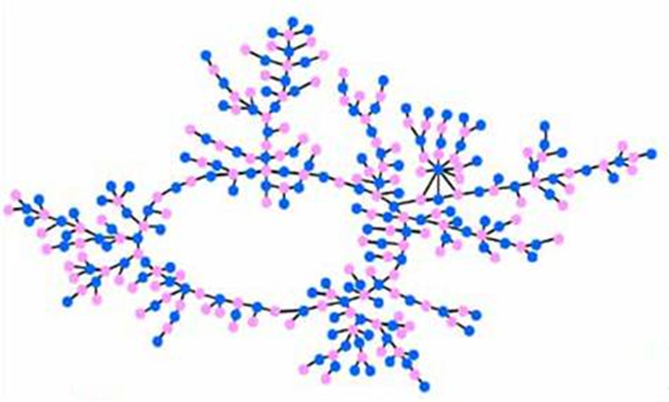
Publishing Network Data
Goal: Enable sharing of social-network data under rigorous privacy guarantees & maintain data utility for statistical inference.
Epidemiological studies on sexual networks
Survey number of partners – Degree Sequence
Reconstruct a typical network
Can we do this while protecting the privacy of individuals?
Anonymization not sufficient e.g. see Narayanan, Shmatikov (2009)
Image Ref: American J. Sociology, Bearman, Moody, Stovel

Slide 105
Publishing network data
Algorithm for releasing graphical degree sequences and synthetic graphs for simple undirected graphs under DP framework.
Relationships
Database
Users
Queries
Government,
researchers,
businesses
(or)
Malicious
adversary
f(G)
e.g. Degree Sequence
answers
Synthetic Graph
Goal
Utility - Release synthetic graphs with given degree sequences with statistical utility
Risk - Provide rigorous privacy guarantee, no assumptions about attacker’s prior information/algorithm

Slide 106
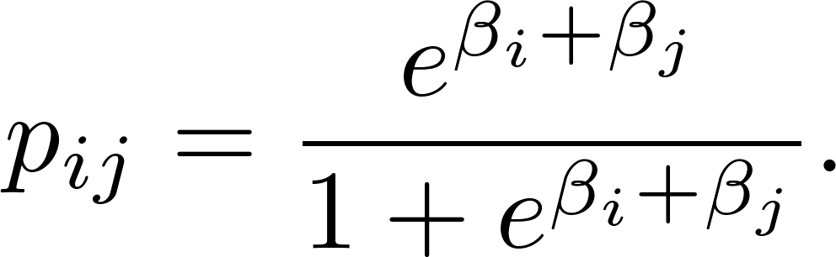
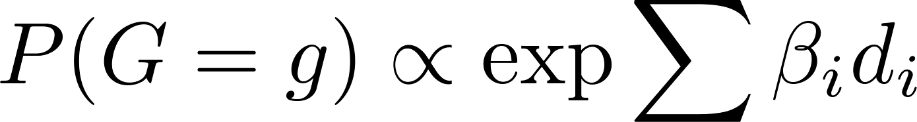
Utility - Beta Model for Graphs
Let G be a graph on n nodes and m edges,
Exponential family - Degree sequence is a sufficient statistic
2
3
4
d={2,2,2,2,1}
5
1
Find the MLE and perform conditional inference – similar to contingency tables analysis
Chatterjeee et al.(2011), Rinaldo et al. (2012)

Slide 107
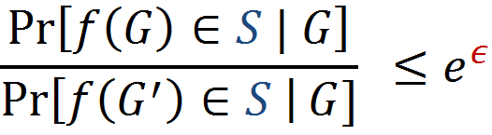
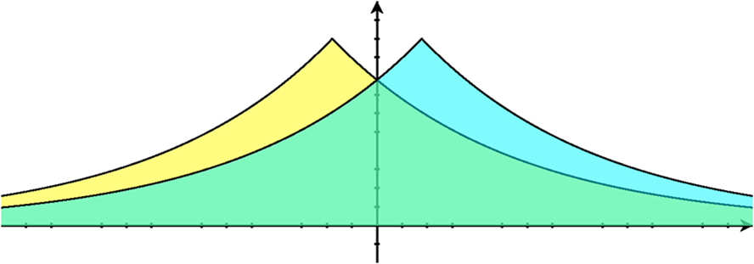
Risk - Differential privacy for relationships
ϵ-differential edge privacy:
For all pairs of neighbors G, G’ and for all events S:
Probability is over the randomness of mechanism f
Definition requires that the distributions are close:
f(G)
f(G’)

Slide 108
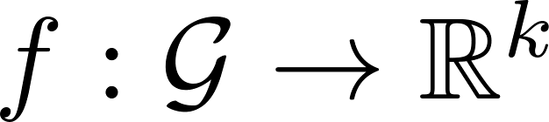

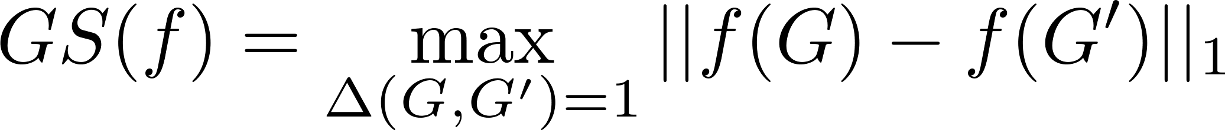
Laplace Mechanism
Laplace Mechanism:
Global Sensitivity:
f(G) a synthetic graph under beta model?
Release sufficient statistics of the beta model
Let f(G) degree sequence with GS(f)=2
BUT utility for MLE existence and for GOF testing requires output to be graphical degree sequence

Slide 109
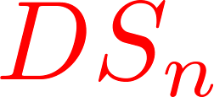
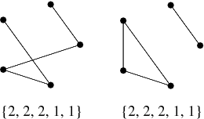
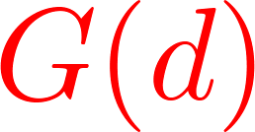
Graphical Degree Sequences
A degree sequence is graphical if it has a simple graph associated with it.
E.g. (2,2,2,1,1) is graphical. (2,2,1,1,1) is not.
Conditions for graphicality – Havel ‘55, Hakimi ‘62
If a sequence is graphical, it may have more than one graph associated with it.
Set of graphical degree sequences is
Set of all graphs that have the same degree sequence is

Slide 110
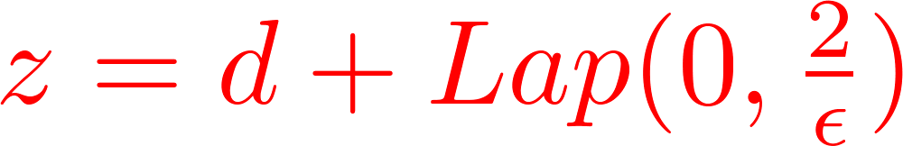

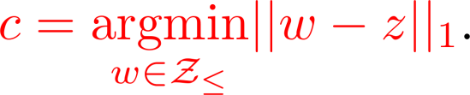

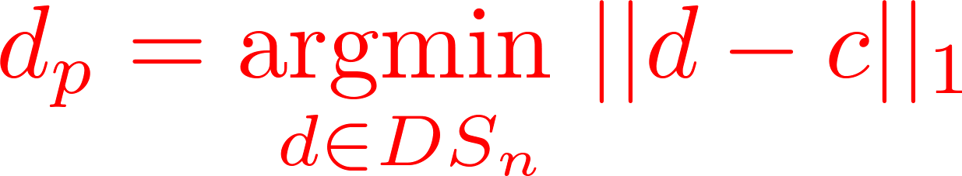
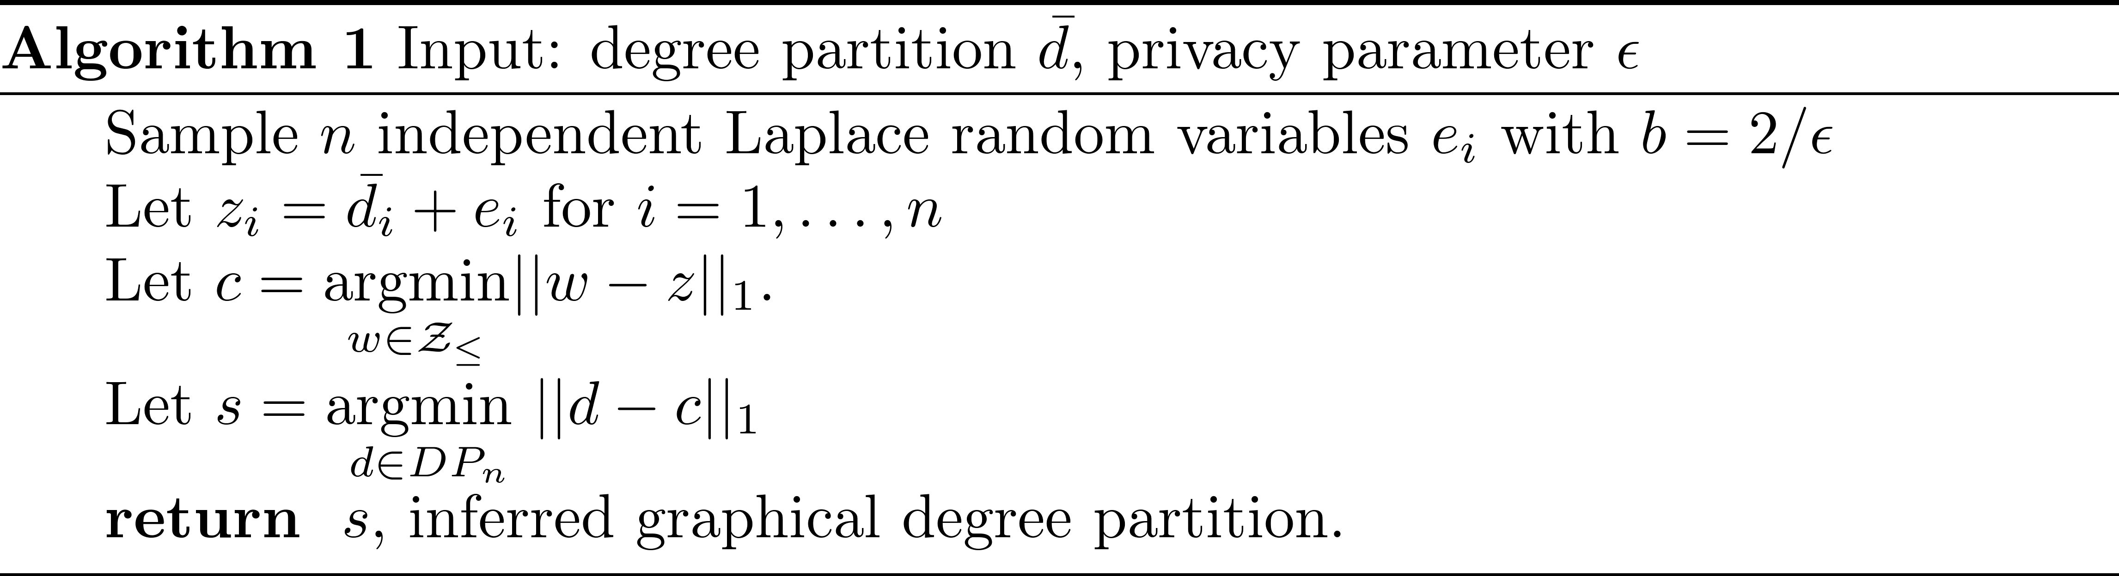
Algorithm for Differentially Private Graphical Degree Sequences
Input : Degree Sequence d
Output : Differentially private synthetic graph G
1)Use the Laplace Mechanism
2) Find the nearest non-decreasing set of integers to
3) Find the nearest graphical degree sequence to
4) Output a graph G associated with d_{p}
“Isotone”
Hay et al (2009)
“Isotone Havel-Hakimi”
Karwa and Slavkovic (2012)

Slide 111
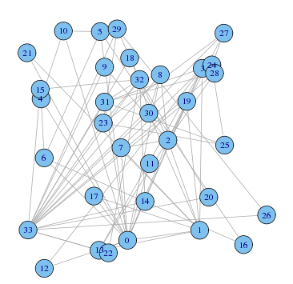
Simulation Results
Goal – Release synthetic datasets from the beta model
Compare – Our algorithm (IsotoneHH) with Hay et al. (Isotone)
Likoma | n=250, m = 248 | Degree sequence of people on Likoma Island
Karate | n = 34, m = 78 | Network of Members of Karate club
Simulation settings:
Start with a graphical degree sequence
Release graphical degree sequences with Laplace noise 500 times.
3) Compute the MLE of the beta model
a) Check for the existence of MLE via Karwa & Slavkovic Theorem
b) If MLE exists, estimate the parameters

Slide 112
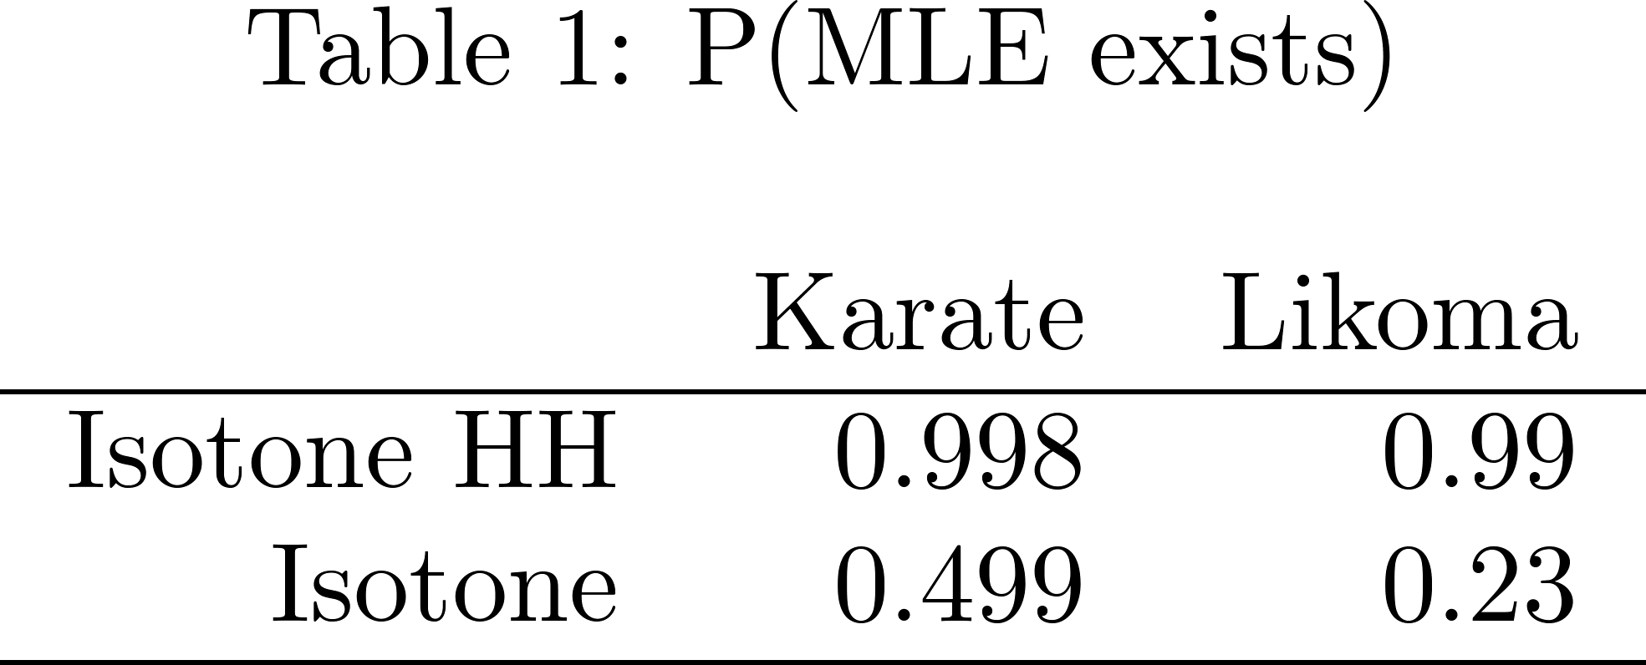
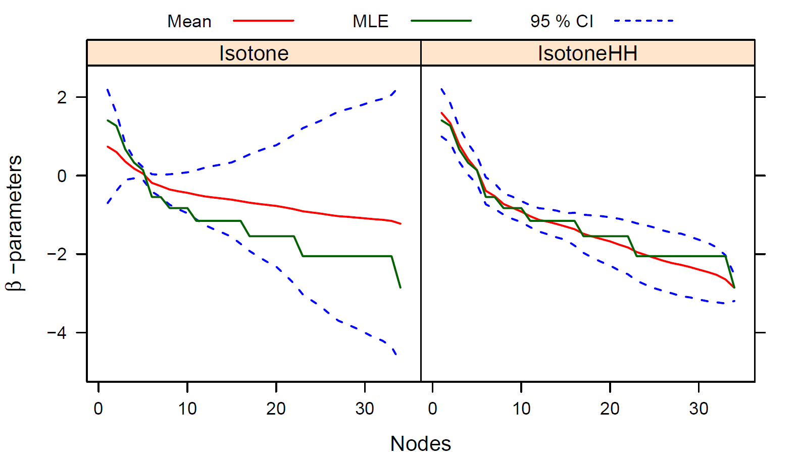
Simulation Results – Karate Data
Notes:
Normalize mean L2 error

Slide 113
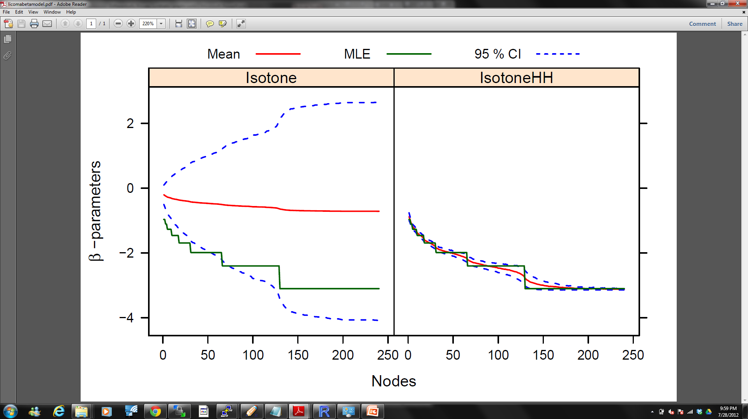
Simulation Results – Likoma Data
Notes:
Normalize mean L2 error

Slide 114
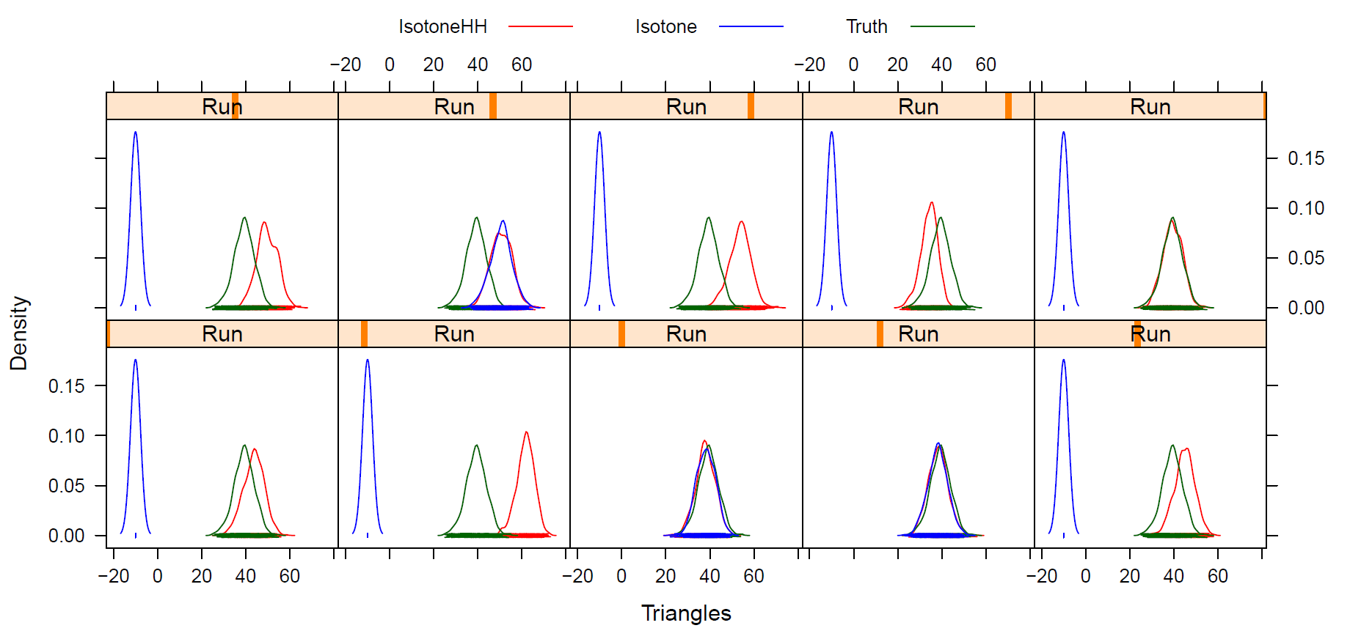
GOF: Empirical Distribution of number of triangles

Slide 115
Summary
Algorithm to release differentially private graphical degree sequences
Equivalent to maximum likelihood reconstruction of degree sequences
If the MLEs of the observed degree partition exist, the the MLEs of the private version of the degree partition should also exist.
Rigorous privacy guarantee AND statistical utility for the beta model
L₁ or L₂ distance between the original and released DP “data” is not sufficient for statistical utility
Ongoing work: extensions to other network models and data
Ref: Vishesh Karwa, Aleksandra Slavkovic, “Differentially private graphical degree sequences”, Privacy in Statistical Databases, Sept’ 2012

Slide 116
NIH Guidelines
Health Insurance Portability and Accountability Act of 1996 (HIPAA)
http://www.hhs.gov/ocr/privacy/hipaa/understanding/index.html
HIPAA Privacy Rule: provides a formal legally enforceable policy for safe guarding protected health information (PHI)
HIPAA Security Rule: specifies administrative, physical, and technical safeguards to assure the confidentiality, integrity, and availability of electronic protected health information (ePHI).
HIPAA Final Rule (ACTIVE as of MARCH 26, 2013): implements a number of provisions of the Health Information Technology for Economic and Clinical Health (HITECH) Act, strengthen the privacy and security of health information
Data sharing, data enclaves, encryption of limited data, privacy risk assessment:
http://grants.nih.gov/grants/policy/data_sharing/data_sharing_guidance.htm#goals

Slide 117
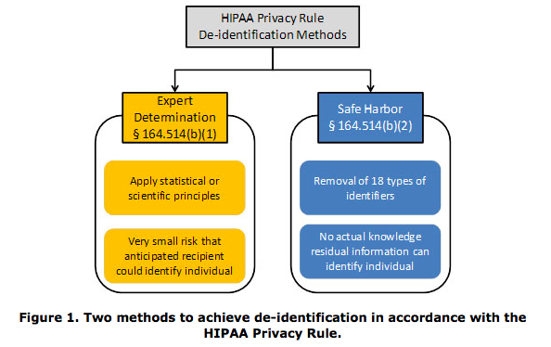
De-Identification
http://www.hhs.gov/ocr/privacy/hipaa/understanding/coveredentities/De-identification/guidance.html

Slide 118
The identities of data subjects cannot be readily ascertained or otherwise associated with the data by the repository staff or secondary data users (Common Rule); and the following data elements have been removed (HIPAA Privacy Rule).
Names.
All geographic subdivisions smaller than a state, including street address, city, county, precinct, ZIP Code, and their equivalent geographical codes, except for the initial three digits of a ZIP Code if, according to the current publicly available data from the Bureau of the Census: a. The geographic unit formed by combining all ZIP Codes with the same three initial digits contains more than 20,000 people. b. The initial three digits of a ZIP Code for all such geographic units containing 20,000 or fewer people are changed to 000.
All elements of dates (except year) for dates directly related to an individual, including birth date, admission date, discharge date, date of death; and all ages over 89 and all elements of dates (including year) indicative of such age, except that such ages and elements may be aggregated into a single category of age 90 or older.
Telephone numbers.
Facsimile numbers.
Electronic mail addresses.
Social security numbers.
Medical record numbers.
Health plan beneficiary numbers.
Account numbers.
Certificate/license numbers.
Vehicle identifiers and serial numbers, including license plate numbers.
Device identifiers and serial numbers.
Web universal resource locators (URLs).
Internet protocol (IP) addresses numbers.
Biometric identifiers, including fingerprints and voiceprints.
Full-face photographic images and any comparable images.
Any other unique identifying number, characteristic, or code, unless otherwise permitted by the Privacy Rule for re-identification

Slide 119
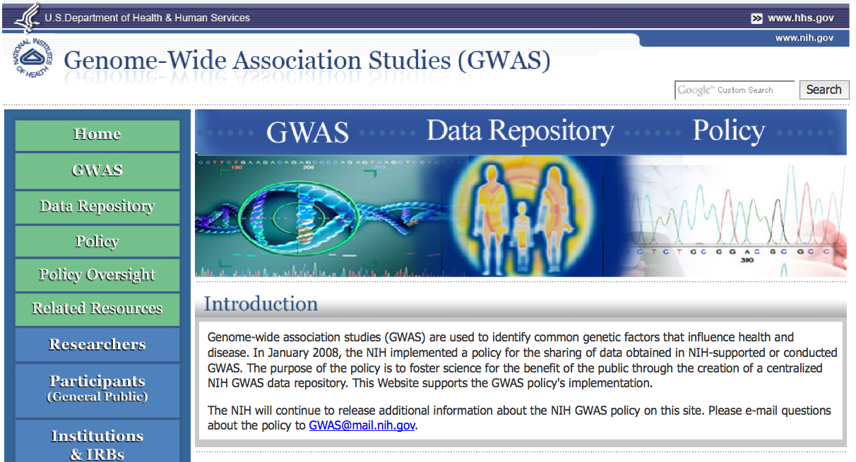
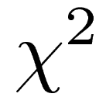
NIH GWAS: Identifiability of de-identified data
2008 Policy on GWAS data sharing @ http://gwas.nih.gov/
http://grants.nih.gov/grants/guide/notice-files/NOT-OD-07-088.html
Data repository, Data submission, Data access

Slide 120
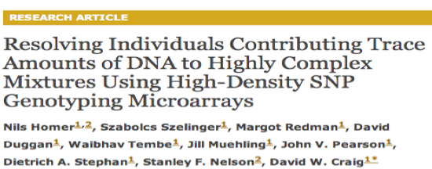
NIH GWAS: Identifiability of de-identified data
Possible to identify a specific individual’s genetic profile in a dataset containing only aggregated genomic data
NIH removed all aggregate genomic data (contingency tables, odds-ratios, of χ² statistics, p-values) from public websites
Access only through a formal approval process
http://gwas.nih.gov/pdf/Compilation_of_Aggregate_Gnomic_Data.pdf
PLoS Genetics 2008, 4(8): e1000167

Slide 121
Private data sharing of GWAS statistics
Uhler, C., Slavkovic, A. and Fienberg, S. “Privacy Preserving Data Sharing for GWAS.” J of Privacy and Confidentiality. (To Appear) & Proc. ICDM 2012.
Aim: Release aggregate genomic data and relevant summary statistics to enable data sharing for exploratory statistical analysis but minimize risk to study participants (and others).
Approach: Differential privacy provides rigorous privacy guarantees in the presence of arbitrary external information
Contribution: Release of private χ² statistics, p-values, and most significant single-nucleotide polymorphisms (SNPs) via differentially private logistic regression with the following cost of privacy:
- For small to large N and no sparseness, with private χ2 statistics minimal cost
- For most relevant SNPs, moderate sample size increases
- For bigger and sparser data, models that integrate across SNPs, these simple releases are not sufficient for privacy nor utility

Slide 122
Overall project summary
Integrating the SDL and cryptographic approaches
Design scalable computational techniques that are statistically sound, yield broadly useful data and preserve privacy in the face of external information.
(1) Integrating the rigorous definitions of privacy emanating from computer science with notions of utility from statistics.
(2) Developing cryptographic protocols for distributing privacy‐ preserving algorithms among a group of servers to avoid pooling data in any single location.
(3) Understanding the practical potential of the developed techniques by applying them to social, behavioral and economic sciences data
Many ongoing problems being worked on.

